Slide 1
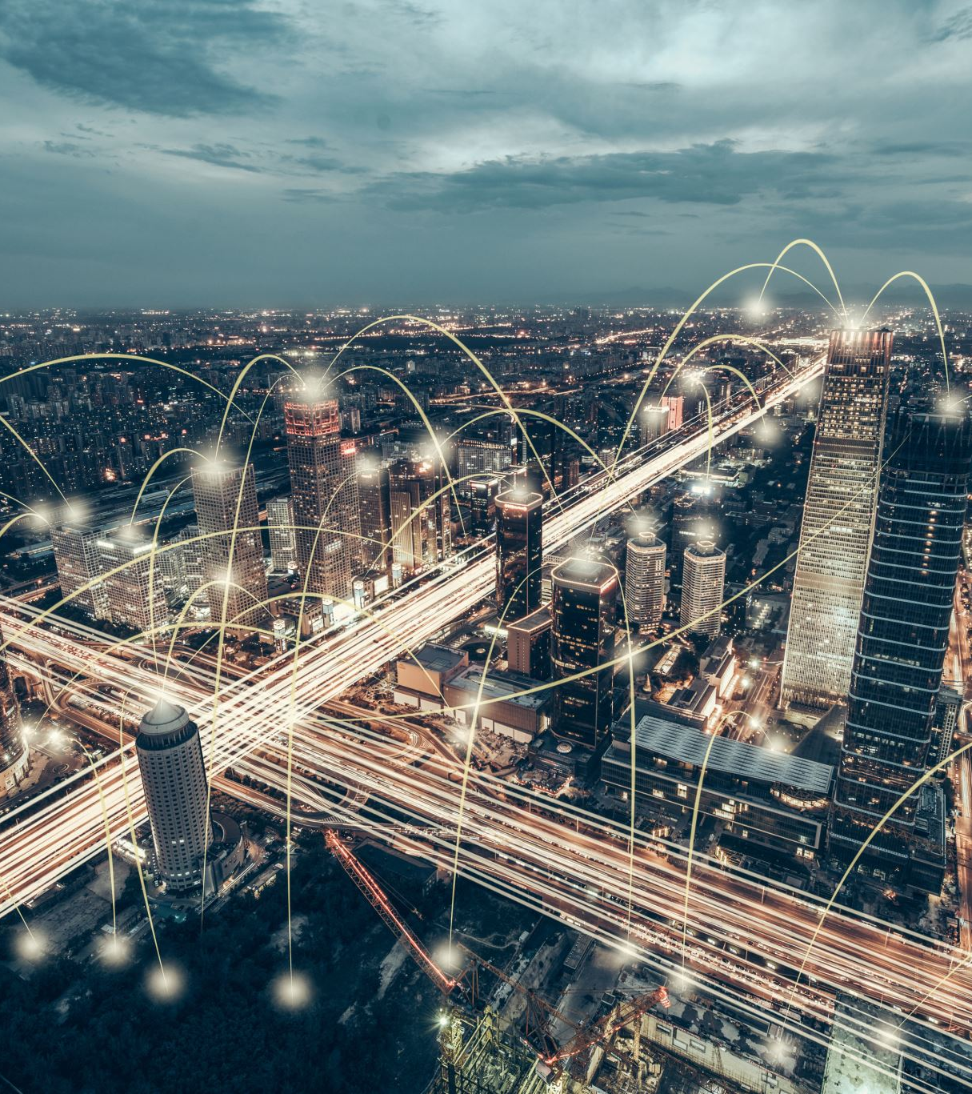
VIRTUAL COFFEE WITH CONSULTING CYBERSECURITY – THE MILE-HIGH VIEW FOR RECORDS AND INFORMATION MANAGEMENT PROFESSIONALS
with Elizabeth Khan & Dr. S. M. Loo

Slide 2
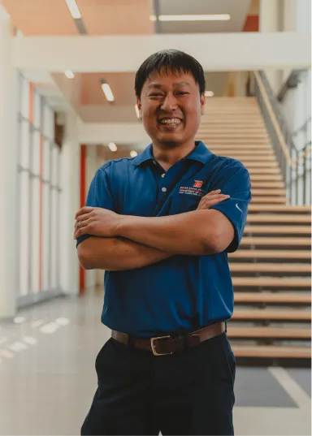
Elizabeth Khan
A successful entrepreneur, Elizabeth has launched, operated, and sold numerous successful ventures in a wide array of forums.. Having recently attained a master’s degree and various cybersecurity industry certifications and credentials., Elizabeth has expanded into the field of cybersecurity with a focus on compliance. She also works as a security auditor for a large healthcare organization and freelances as an instructor for Boise State University’s Cyber Operations and Resilience program.
Dr. S. M. Loo is the Cyber Operations and Resilience (CORe) Program Director. He leads the effort in offering asynchronous online cyber operations and resilience programs. He is also a professor of Electrical and Computer Engineering at Boise State University. He holds a joint-appointment with Idaho National Laboratory.

Slide 3
WHY ARE WE HERE?
Notes:
We’re here to talk about cybersecurity. We hear about it a lot today..
It seems that there isn’t a day that goes by now that we don’t hear about another cyber attack.

Slide 4
WHAT IS CYBERSECURITY?
Cybersecurity is the art of protecting networks, devices, and data from unauthorized access or criminal use and the practice of ensuring Confidentiality, Integrity, and Availability of information.
[https://www.cisa.gov/uscert/ncas/tips/ST04-001]

Slide 5
INCREASED RISK
Notes:
In fact.. Significant increase in attacks just in the short period between 2020-2021.

Slide 6
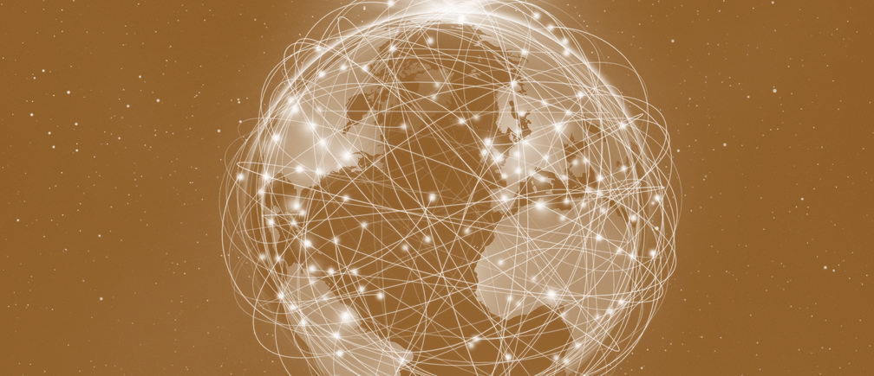
HOW DID WE GET HERE?
1970s
1990s
1960s
1980s
2000s
Notes:
The internet originally created to share information. It wasn’t built specifically to be what
it is today. and so security wasn’t at the heart of the infrastructure ..rather it was about free access to information..
By that I mean in the situation where we are under siege.
Let’s take a moment to briefly understand the chronology of events.
The advent of the internet was revolutionary… changed the way we do business,
bank, work, and even date. The speed of innovation in the past 20 years has led to the
current evolution of the internet which is a massive interconnected global always on
electronic village that has in us rubbing shoulders with unknown virtual neighbors
criminals and cartels alike.

Slide 7
WHY DOES IT MATTER?
Notes:
Like many innovations there can be unintended consequences. and one of the
unintended consequences of this highly networked dynamic world is that now
most of our lives have migrated to the digital environment. And although that’s convenient. comes with new risks.

Slide 8
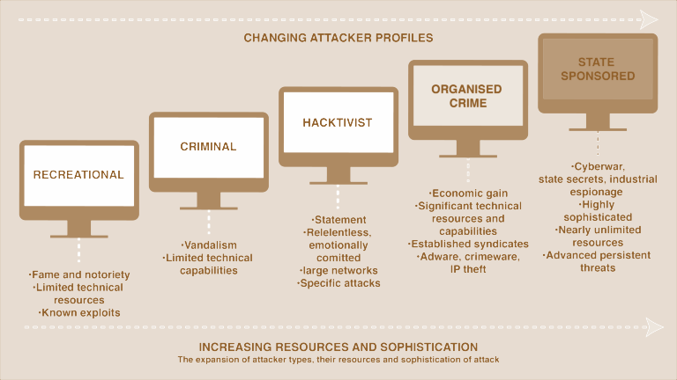
INTERTWINED ECOSYSTEM
Notes:
https://www.futurelearn.com/info/courses/the-cyber-security-landscape-et/0/steps/60317

Slide 9
IT MATTERS BECAUSE
Our personal lives depend on it
Businesses depends on it
National Security depends on it
Notes:
National Security: 16 critical infrastructure sectors (finance/health) and if you fall
within these areas even more regulation.

Slide 10
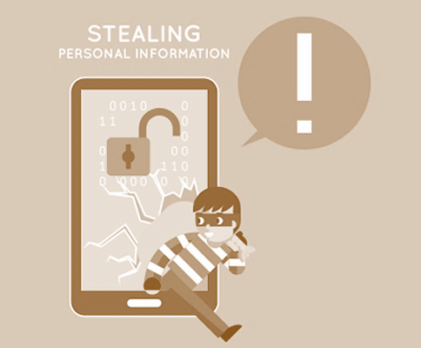
SO MUCH OF OUR LIVES ARE DIGITAL, LEADING TO NEW PERSONAL RISKS
Notes:
Share with you why it matters to me.. personally... protect personal assets
digital.. so much of our lives are digital. Personal information exposed like never before.. So many devices (IoT connected to the internet).. Increase attack surface and risk..
new risks to my banking/finances/privacy that didn’t exist before.

Slide 11
GOING OUT OF BUSINESS
60% of small businesses go out of business within six months of falling victim to a data breach or cyber attack.
Notes:
https://cybersecurityventures.com/60-percent-of-small-companies-close-within-6-months-of-being-hacked/
ANOTHER WHY!! Potential Impacts -cost of a breach/go out of business within 6 months of a attack

Slide 12
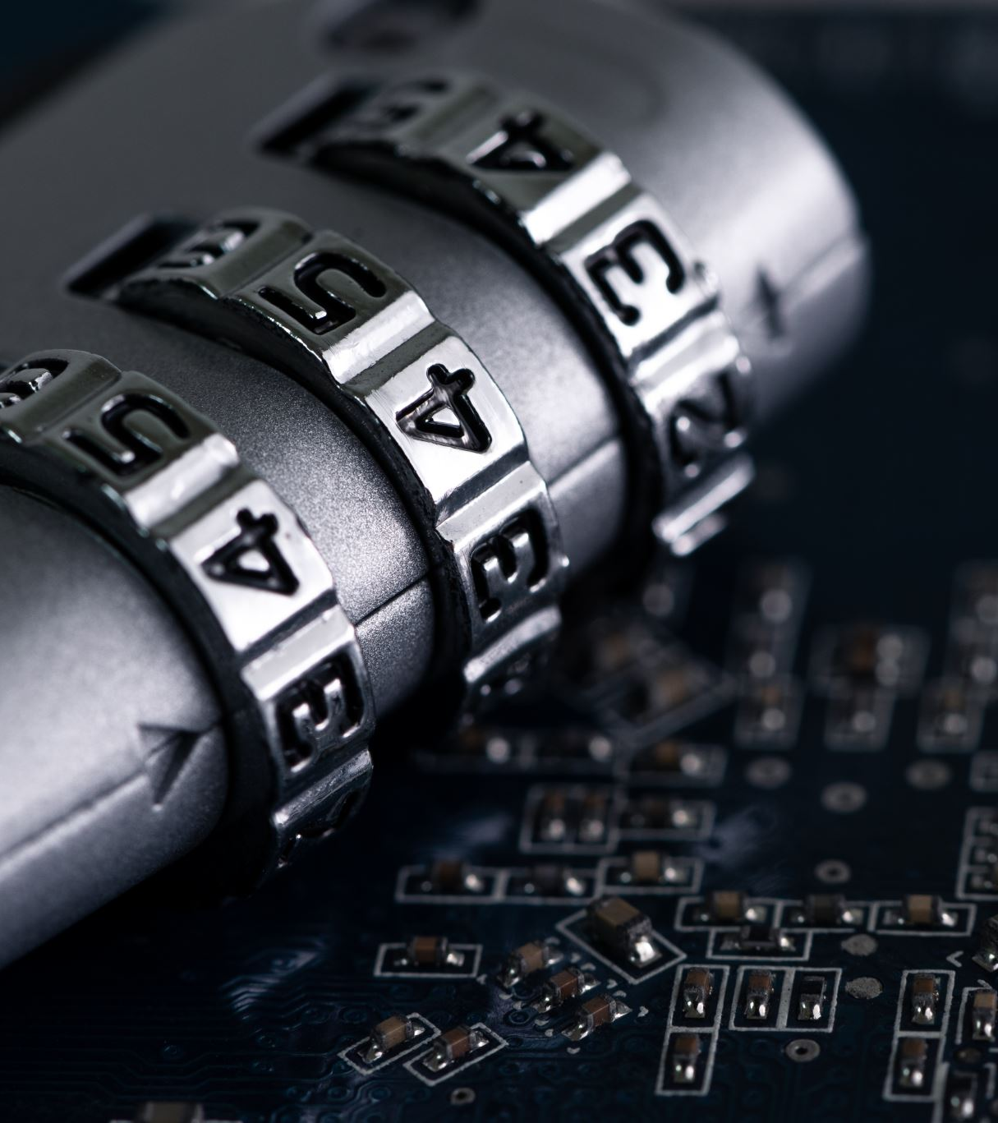
LAWS & REGULATIONS
HIPAA
PCI DSS
NY DFS
FISMA
Notes:
Then of course there are governing regulatory frameworks ….such as HIPAA, PCI DSS..NY DFS some changes coming up 2023-year cybersecurity

Slide 13
SIGNIFICANT FINES FOR NON-COMPLIANCE
575 Million
Equifax breach: Failed to fix a critical vulnerability months after patch was released. Failed to inform the public for weeks.
277 Million
Facebook breach: Compromise of 500 million users’ personal information. Concerned questions of compliance with GDPR obligation for Data Protection by Design and Default.
200 Million
Home Depot breach: Stolen credentials from a third party enabled attackers to enter Home Depot’s network, elevate privileges, and eventually compromise the POS system.
Notes:
https://www.csoonline.com/article/3410278/the-biggest-data-breach-fines-penalties-and-settlements-so-far.html we are seeing the trend for at the CEO level for failure to implement necessary info sec program. Tip of the iceberg.. Not all reported..fear of reprisals..

Slide 14
THIRD-PARTY ASSURANCE
Increasingly buyers are looking to the supply chain ecosystem and seeking assurances third party suppliers are meeting minimum IT standards.
Third parties are common source of data breaches
It’s the law
Their standards might not be your standards
Hackers are becoming even more sophisticated
Notes:
https://panorays.com/blog/4-reasons-why-you-should-care-about-third-party-cybersecurity/
differentiator in the industry.. Which company do you want to give you money too.. Going to become a part of corporate responsibility..
Reputation: it’s good business and branding to implement cybersecurity measures… these are some of the WHYS..and we could probably cover a lot more..but, this is to give you some ideas to think about..

Slide 15
CRITICAL INFRASTRUCTURE SECTORS
Chemical
Commercial Facilities
Communications
Critical Manufacturing
Dams
Defense Industrial Base
Emergency Services
Energy
Financial Services
Food and Agriculture
Government Facilities
Healthcare and Public Health
Information Technology
Nuclear Reactors, Materials, and Waster
Transportation Systems
Water and Wastewater Systems
Notes:
https://www.cisa.gov/critical-infrastructure-sectors

Slide 16
CURRENT SITUATION
Please be secure, that’d be great!
Many industries outside of the critical infrastructure are asked to voluntarily adopt cybersecurity practices, rather than being mandated to comply
Notes:
“In remote work environments, some staff intentionally go around cybersecurity requirements while home distractions cause unintended lapses in cybersecurity judgment, according to a study. So, on one hand, some might outright ignore cybersecurity guidelines depending on the rule. And, that’s only if an enterprise elects to follow cyber guidelines and recommended security strategies.”
https://bytagig.com/voluntary-compliance-just-isnt-enough-for-cybersecurity-measures/

Slide 17
ANTICIPATED REGULATORY CHANGES COMING THIS YEAR…
Imposing of mandatory regulations on a wide range of American industries.
Will authorize U.S. defense, intelligence, and law enforcement agencies to go on the offensive, hacking into the computer networks of criminals and foreign governments, in retaliation to—or preempting—their attacks on American networks.
Notes:
https://slate.com/news-and-politics/2023/01/biden-cybersecurity-inglis-neuberger.html DHS/CISA NY FS changes.. Still in a comment period.
https://www.hklaw.com/en/insights/publications/2023/01/new-regulatory-agenda-reveals-forthcoming-cybersecurity-regulations

Slide 18
WHAT CAN BE DONE?
IMPLEMENTING TECHNICAL CONTROLS
PRACTICING GOOD CYBER HYGIENE
UNDERSTANDING YOUR BUSINESS AND ITS RISK APPETITE
Notes:
And, so if we know why then our next question might be ‘what?” And I think that’s probably really why we are here today..to consider the potential impact on our our lives our businesses and how we start thinking about how to better protect
ourselves and become cybersavvy.. we can start to do this … ADMIN/TECH/PHYSICAL CONTROLS better known as safeguards… also understanding biz and risk.. and this is where..

Slide 19
TODAY WE WILL FOCUS ON
Social Engineering
Password Security
Patch Management
Ransomware
Business Continuity
Notes:
So today we will focus on…

Slide 20
SOCIAL ENGINEERING:
a manipulation technique that exploits human error to gain private information, access, or valuables.
Notes:
https://usa.kaspersky.com/resource-center/definitions/what-is-social-engineering

Slide 21
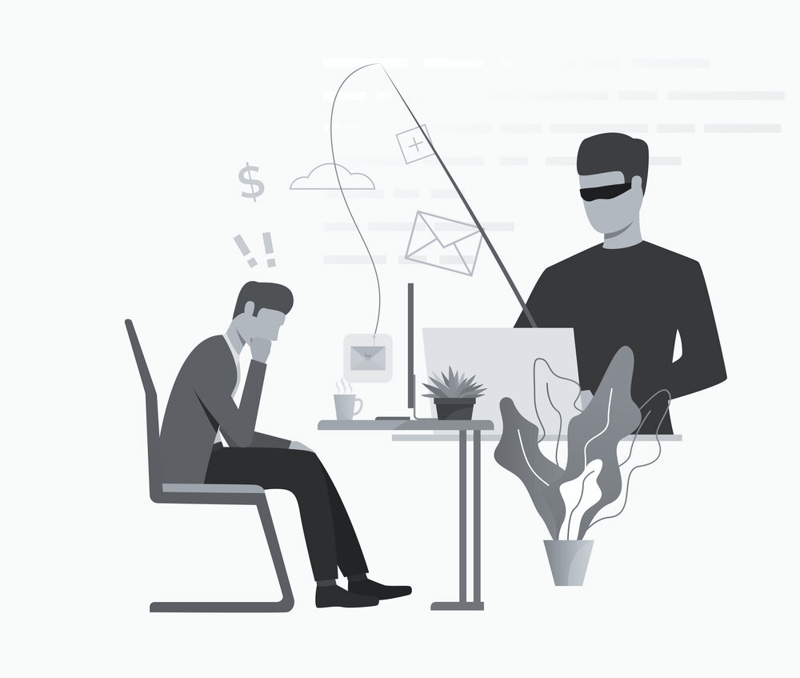
PHISHING
According to recent research from IRONSCALES, 81% of organizations around the world have experienced an increase in email phishing attacks since March 2020.
Mar. 2020
2021
In fact, according to Verizon’s 2021 DBIR, around 25% of all data breaches involve phishing and 85% of data breaches involve a human element.
Notes:
Verizon Data Breach Investigation Report finds that Phishing still dominates cyberattacks.
https://www.proofpoint.com/us/blog/email-and-cloud-threats/key-findings-2022-verizon-data-breach-investigations-report-dbir

Slide 22
SOCIAL ENGINEERING COUNTERMEASURES
Set Policies and Procedures
Internet Usage
Separation of Duties
Password Policy
Security Awareness Training
Regular Mandatory Training for all employees
Technical Measures
Physical Access Systems
Identity Verification
Email/Web Filtering
Notes:
https://www.rangeforce.com/blog/social-engineering-countermeasures

Slide 23
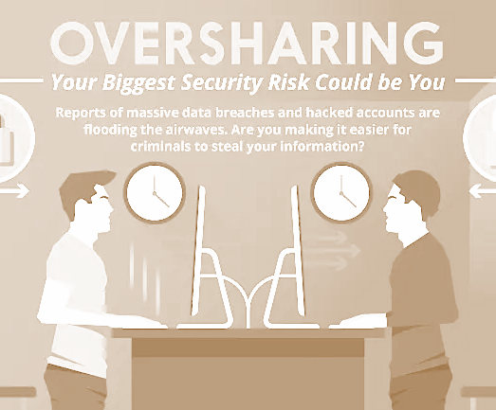
SOCIAL MEDIA CAUTION
Posting personal information.
Trusting relationships formed online.
Social media sites that have little to no security.

Slide 24
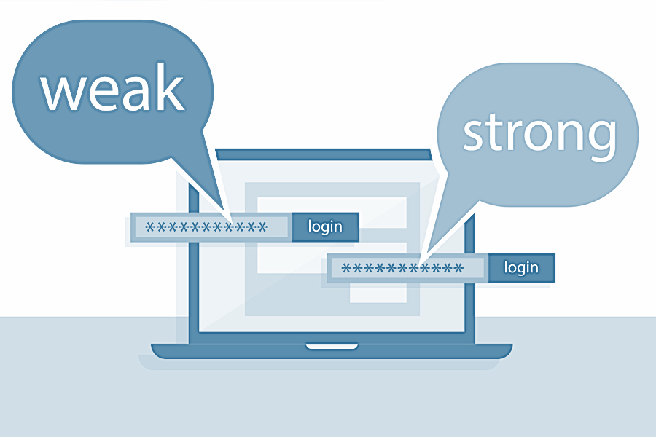
PASSWORD SECURITY
A Password is a secret combination of letters, numbers, and/or characters that only the user should know.
A password is the first line of defense in securing information systems.

Slide 25
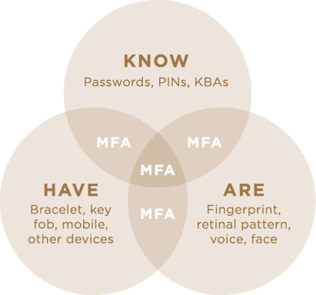
MULTI-FACTOR AUTHENTICATION
Notes:
Latest guidance NIST last year was password complexity.. over 12 letters.. mixed…..

Slide 26
PATCH MANAGEMENT
Patch management is the process of distributing and applying updates to software. These patches are often necessary to correct errors (also referred to as “vulnerabilities” or “bugs”) in the software.
Notes:
That means ensuring that you get your software updates installed. Don’t hit the do it later button too often. Or set a policy that after x number of deferrals system won’t operate until patch applied.

Slide 27
THOSE WHO FAIL TO PLAN, PLAN TO FAIL
“According to the Ponemon Institute, 57% of cyberattack victims report that their breaches could have been prevented by installing an available patch, and even more chilling, 34% of those victims knew of the vulnerability but hadn't taken action."
Notes:
https://www.cnp.net/patching-best-practices/

Slide 28
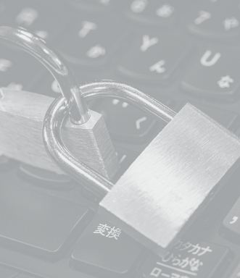
RANSOMWARE:
An ever-evolving form of malware designed to encrypt files on a device, rendering any files and the systems that rely on them unusable. Malicious actors then demand ransom in exchange for decryption.
Notes:
Incident response plan. Insurance policy. Call an expert. Note agencies do not support payment of a ransom.
We are seeing a lot of ransomware attacks.. some of the top targets for criminals are health care industry as that information is worth more on the dark web.

Slide 29
PREVENTATIVE MEASURES
Regular Vulnerability Scanning
Backup, Backup, Backup
Regularly Patch and Update System
User Authentication
Business Continuity Planning
Notes:
https://www.checkpoint.com/cyber-hub/threat-prevention/ransomware/

Slide 30
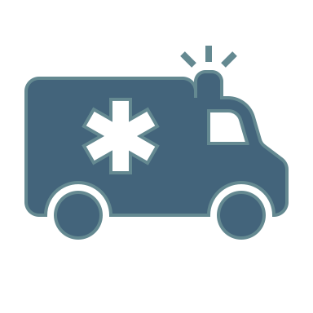
Business continuity is a business’s level of readiness to maintain critical functions after an emergency or disruption.
Resilience!
Notes:
https://www.vmware.com/topics/glossary/content/business-continuity.html

Slide 31
BUSINESS CONTINUITY COVERS
Incident Response
Disaster Recovery
Notes:
NEED TO HAVE A PLAN.. NOT A MATTER OF IF BUT WHEN YOU WILL BE BREACHED..

Slide 32
IMPORTANCE OF INCIDENT RESPONSE
Responding to an incident quickly will help an organization minimize losses, mitigate exploited vulnerabilities, restore services and processes and reduce the risks that future incidents pose.
Notes:
https://www.techtarget.com/searchsecurity/definition/incident-response Need to have an incident response plan. Last thing you want to do is be figuring it out at 3am in the morning and you don’t know who to call systems offline. Need a call tree.. Steps that need to be outlined.. First one is authenticate an incident has occurred.. (not just unplugged)

Slide 33
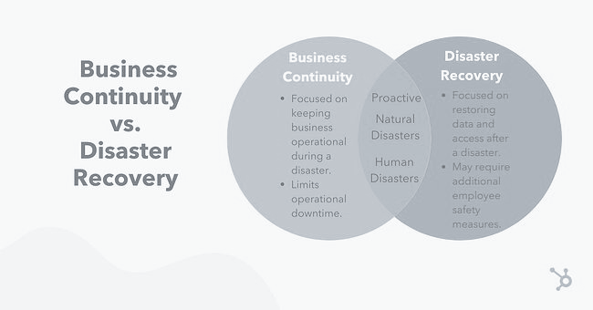
BUSINESS CONTINUITY PLANNING
Notes:
https://blog.hubspot.com/service/business-continuity-plan Warm sites, hot sites, mirror sites using cloud

Slide 34
WHY IS DISASTER RECOVERY IMPORTANT?
By anticipating and addressing technology-related disasters, an organization can respond promptly to these disruptive events and, in doing so, ensure business continuity.
No longer if but when…
Resilience
Notes:
https://aws.amazon.com/what-is/disaster-recovery/

Slide 35
ARE YOU PANICKING?
What should I do next?
WE CAN HELP!!
Risk Assessment
Capstone Projects
Consulting

Slide 36
Compliance
Security Awareness
Cyber Risk Assessments
Vulnerability Testing

Slide 37
TRAINING THROUGH ACADEMIC CERTIFICATES & DEGREES
If you have an undergraduate in any field and if you are interested in cyber, we have a degree for you to pivot!
go.boisestate.edu/ucore
go.boisestate.edu/gcore

Slide 38
THANK YOU!
Elizabeth Khan
RCSS Group
Info@rcssgrp.com
Dr. S. M. Loo
Boise State University
smloo@boisestate.edu
If you have any additional questions, please reach out.
Notes:
Did you want to share something personal here?

